Slide 1


Biblioteca 1-Wire para sAPI Proyecto CIAA
Protocolos de Comunicación en Sistemas Embebidos Carrera de Especialización de Sistemas Embebidos
Autor: Ing. Mauro Moreyra
Agosto 2018

Slide 2


Protocolo 1-Wire Conceptos básicos
Diseñado por Dallas Semiconductor (±1988), hoy parte de Maxim Integrated (2001).
Provee transferencia de datos a baja velocidad (estándar hasta 15.4 Kbps, overdrive hasta 125 Kbps) y energía (power) sobre un único cable + GND.
Comunicación half-duplex (bidireccional).
No requiere clock: el bus se sincroniza con los flancos negativos de los pulsos del master.
Opera con niveles CMOS/TTL.

Slide 3
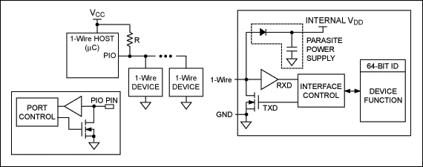
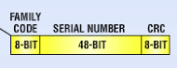
Protocolo 1-Wire Esquemático bus
MAESTRO
2k2 ✓
ESCLAVOS MicroLan™
“LASERED ROM”
Notes:
64-Bit ID se comporta como una MAC ADDRESS, código único e irrepetible entre todos los dispositivos 1-Wire.

Slide 4

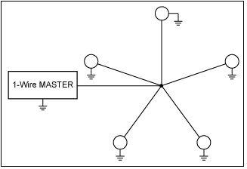
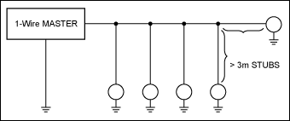
Protocolo 1-Wire Topologías de red
Lineal
Estrella
Stubbed
Notes:
Es a modo ilustrativo… tener en cuenta que en topologías complejas (estrella o redes switcheadas), aparecen otros factores a considerar: impedancia distribuida, problemas con las fuentes parásitas distribuidas, los tiempos de propagación según el largo de los cables, etc.

Slide 5
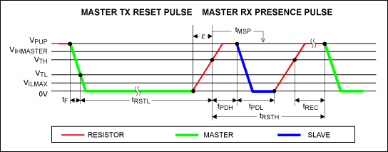
Protocolo 1-Wire Señalización
Pulso de reset (Master) y pulso de presencia (Esclavo).
Notes:
Hay 4 operaciones atómicas básicas con las que se construyen las comunicaciones mediante 1-Wire.
1-Wire communication begins with a reset-/presence-detect cycle (Figure 1). To get from idle to active, the voltage on the 1-Wire bus must fall from V_{PUP}below the threshold, V_{TL}. To get from active to idle, the voltage needs to rise from V_{ILMAX} past the threshold, V_{TH}. The time it takes for the voltage to make this rise is seen in Figure 1 as "ε," and its duration depends both on the pullup resistor, R_{PUP}, used and the capacitance of the 1-Wire network attached. The voltage V_{ILMAX} is relevant for the slave when determining a logical level, not for triggering any events. If the master uses slew-rate control on the falling edge, the master must pull down the line for t_{RSTL} + t_{F} to compensate for the edge. A t_{RSTL} duration of 480µs or longer exits the Overdrive Mode, returning the device to standard speed. If a slave is in Overdrive Mode and t_{RSTL} is no longer than 80µs, the device remains in Overdrive Mode. If a slave is in Overdrive Mode and t_{RSTL} is between 80µs and 480µs, the device will reset but the communication speed is undetermined. After the bus master has released the line, it goes into receive mode. Now the 1-Wire bus is pulled to V_{PUP} through the pullup resistor. When the threshold, V_{TH}, is crossed, the slave waits for t_{PDH} and then transmits a presence pulse by pulling the line low for t_{PDL}. To detect a presence pulse, the master must test the logical state of the 1-Wire line at t_{MSP}. The t_{RSTH} window must be at least the sum of t_{PDHMAX}, t_{PDLMAX}, and t_{RECMIN}. Immediately after t_{RSTH} is expired, a slave with the new front-end is ready for data communication.
Read/Write Time Slots
After the reset-/presence-detect cycle is completed, a 1-Wire slave is ready for communication using time slots. Each time slot carries a single bit. Write time slots transport data from the bus master to a slave. Read time slots transfer data from a slave to the master. Figure 2 illustrates the definitions of the write and read time slots. A time slot begins with the master pulling the data line low. As the voltage on the 1-Wire line falls below the threshold, V_{TL}, a slave starts its internal timing generator, which determines when the data line is sampled during a write time slot and how long data is valid during a read time slot.

Slide 6
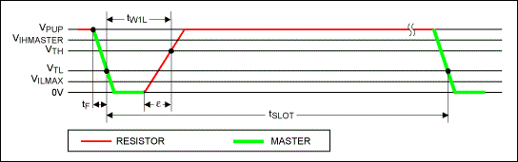
Protocolo 1-Wire Señalización
Write-One time slot.
Notes:
Master-to-Slave
For a write-one time slot, the voltage on the data line must have crossed the V_{TH} threshold before the write-one low time, t_{W1LMAX}, is expired. For a write-zero time slot, the voltage on the data line must stay below the V_{TH} threshold until the write-zero low time, t_{W0LMIN}, is expired. After the V_{TH} threshold has been crossed, a slave needs a recovery time, t_{REC}, before it is ready for the next time slot.

Slide 7
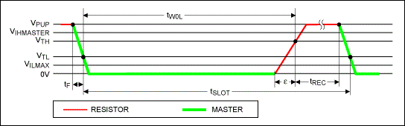
Protocolo 1-Wire Señalización
Write-Zero time slot.

Slide 8
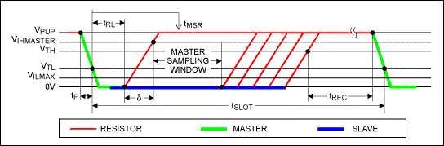
Protocolo 1-Wire Señalización
Read-Data time slot.
Notes:
Slave-to-Master
A read-data time slot begins like a write-one time slot. The voltage on the data line must remain below V_{TL} until the read-low time, t_{RL}, is expired. During the t_{RL} window, when responding with a 0, a slave starts pulling the data line low; its internal timing generator determines when this pulldown ends and the voltage starts rising again. When responding with a 1, a slave does not hold the data line low, and the voltage starts rising as soon as t_{RL} is over. The sum of t_{RL} + δ (rise time) on one side and the internal timing generator of the slave on the other side define the master sampling window, t_{MSRMIN} to t_{MSRMAX}, in which the master must perform a read from the data line. After reading from the data line, the master must wait until t_{SLOT} is expired.

Slide 9
Protocolo 1-Wire Comandos ROM
Comando | Código | Descripción
Read ROM | 0x33 | Leer 64-bit ID (un esclavo)
Skip ROM | 0xCC | Direccionar todos los esclavos conectados al bus
Match ROM | 0x55 | Direccionar función a un único esclavo conectado al bu
Search ROM | 0xF0 | Descubrir el ID de todos los esclavos conectados al bus
Otros comandos: Read scratch; Write scratch; Read status; Write status; etc.

Slide 10
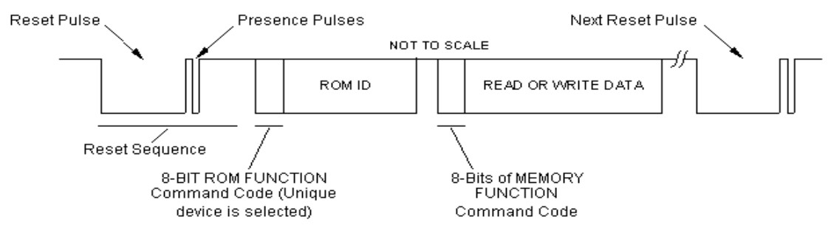
Protocolo 1-Wire Comunicación en tres fases
(OPTIONAL)
Notes:
8-BIT ROM FUNCTION Command Code (Unique device is selected): este envio de comando corresponde únicamente en caso de que querramos seleccionar un único esclavo dentro del bus 1-Wire (obviamente no aplica para buses con un único esclavo).

Slide 11
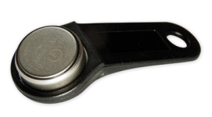
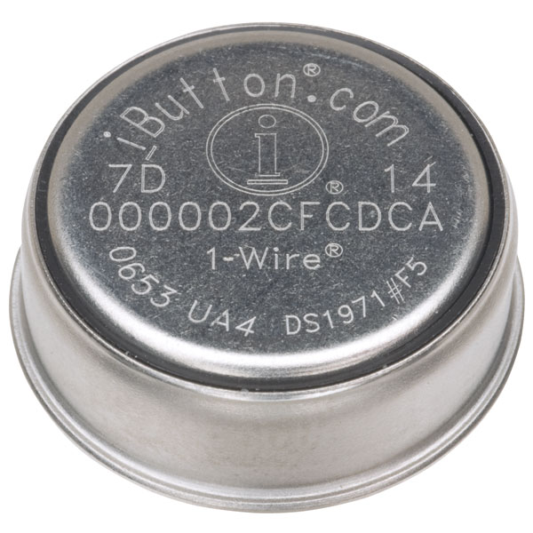
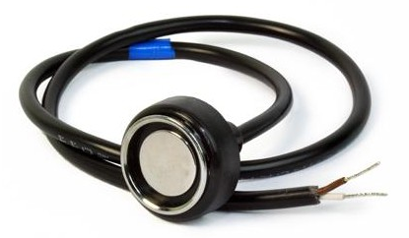
Protocolo 1-Wire Dispositivos 1-Wire: iButtons
Identification only
Identification plus control
Identification plus temperature
Identification plus time (RTC)
Identification plus NV SRAM
Identification plus OTP EPROM
Identification plus EEPROM
Identification plus SHA-1 secure EEPROM
Identification plus logging
Notes:
1-Wire devices are offered in conventional transistor (TO-92) and IC packages (TSOC, SOIC, SOT23). Designed for contact applications and easy attachment, the 2-contact SFN¹ package accommodates parasitically powered 1-Wire devices (Figure 2). The 16mm-diameter stainless steel iButton^{®2} package protects 1-Wire devices from harsh environments, making them suitable for indoor and out door use (Figure 3). Many devices are also available in flip chip (Figure 4) and UCSP^{™3} (Figure 5) versions.

Slide 12
Biblioteca 1-Wire sAPI Características
Estrategia: Bit-Banging por SW + delay bloqueantes.
Funciones públicas básicas (ROM).
Funciones privadas para añadir soporte a más comandos y dispositivos.
6us
64us
@ STANDARD SPEED
60us
10us
9us
55us
0us
480us
70us
410us

Slide 13
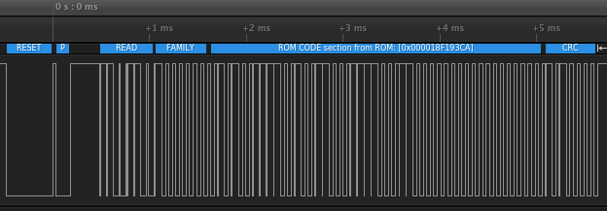
Biblioteca 1-Wire sAPI Testing: Medición con analizador lógico
Secuencia para consulta de datos de ROM.

Slide 14
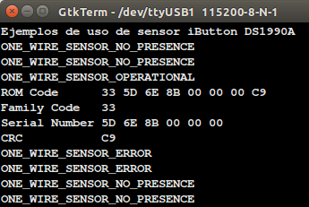
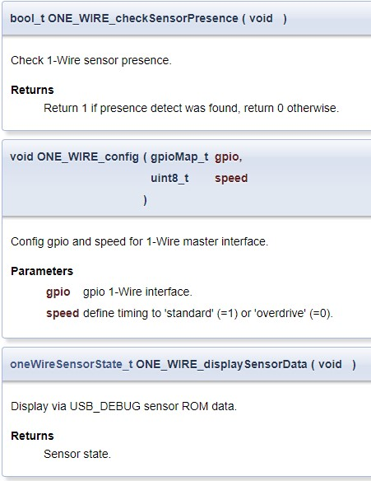
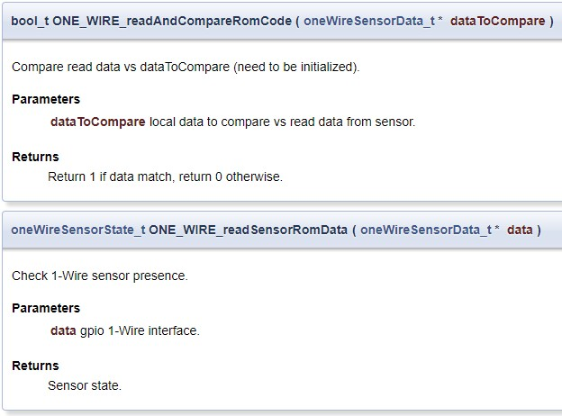
Biblioteca 1-Wire sAPI Demo

Slide 15
Repositorio GitHub y Bibliografía
Repositorio sAPI 1-Wire https://github.com/MauroMoreyra/sapi_oneWire
1-Wire Overview https://www.maximintegrated.com/en/products/1-wire/flash/overview/
1-Wire Communication Through Software https://www.maximintegrated.com/en/app-notes/index.mvp/id/126#
Reading and Writing 1-Wire® Devices Through Serial Interfaces https://www.maximintegrated.com/en/app-notes/index.mvp/id/74
Overview of 1-Wire Technology and Its Use https://www.maximintegrated.com/en/app-notes/index.mvp/id/1796
Complete 1-Wire command codes http://owfs.sourceforge.net/family.html
Guidelines for Reliable Long Line 1-Wire Networks https://www.maximintegrated.com/en/app-notes/index.mvp/id/148

Slide 16
¿Preguntas?

Slide 17
¡Muchas gracias!

